Slide 1
Week:1
Logic

Slide 2
LOGIC:
Logic is the study of the principles and methods that distinguish between a valid and an invalid argument.
SIMPLE STATEMENT:
A statement is a declarative sentence that is either true or false but not both. A statement is also referred to as a proposition
EXAMPLES:
a. 2+2 = 4,
b. It is Sunday today
If a proposition is true, we say that it has a truth value of "true”.
If a proposition is false, its truth value is "false".
The truth values “true” and “false” are, respectively, denoted by the letters T and F.

Slide 3
UNDERSTANDING STATEMENTS
1) x + 2 is positive. Not a statement
2) May I come in? Not a statement
3) Logic is interesting. A statement
4) It is hot today. A statement
5) -1 > 0 A statement
6) x + y = 12 Not a statement

Slide 4
COMPOUND STATEMENT:
Simple statements could be used to build a compound statement.
LOGICAL CONNECTIVES
EXAMPLES:
1. “3 + 2 = 5” and “Lahore is a city in Pakistan”
2. “The grass is green” or “ It is hot today”
3. “Discrete Mathematics is not difficult to me”
AND, OR, NOT are called LOGICAL CONNECTIVES.
SYMBOLIC REPRESENTATION
Statements are symbolically represented by letters such as p, q, r,...

Slide 5
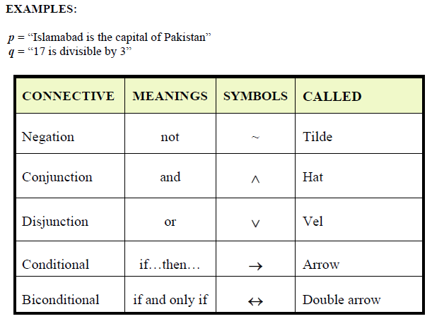

Slide 6
EXAMPLES
p = “Islamabad is the capital of Pakistan”
q = “17 is divisible by 3”
p ∧ q = “Islamabad is the capital of Pakistan and 17 is divisible by 3”
p ∨ q = “Islamabad is the capital of Pakistan or 17 is divisible by 3”
~p = “It is not the case that Islamabad is the capital of Pakistan”
or simply “Islamabad is not the capital of Pakistan”

Slide 7
TRANSLATING FROM ENGLISH TO SYMBOLS
Let p = “It is hot”, and q = “ It is sunny”
SENTENCE SYMBOLIC FORM
1.It is not hot. ~ p 2. It is hot and sunny. p ∧q
3.It is hot or sunny. p ∨ q 4. It is not hot but sunny. ~ p ∧q
5.It is neither hot nor sunny. ~ p ∧ ~ q
EXAMPLE
Let h = “Zia is healthy” and w = “Zia is wealthy”
s = “Zia is wise”
Translate the compound statements to symbolic form:
1) Zia is healthy and wealthy but not wise. (h ∧ w) ∧ (~ s)
2) Zia is not wealthy but he is healthy and wise. ~ w ∧ (h ∧ s)
3) Zia is neither healthy, wealthy nor wise. ~ h ∧ ~ w ∧ ~ s

Slide 8
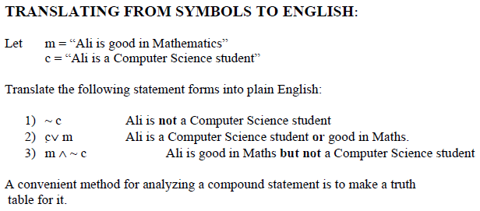

Slide 9
Propositional Logic
Proposition: a declarative sentence that is either true or false but not both.
Examples of three propositions whose value is True:
  p: Toronto is the capital of Canada.
  q: 1 + 0 = 1
  r: There are seven days in a week
  Examples of three propositions whose value is False:
  p: The angles of a triangle add up to 360
  q: London is the capital of France
  r: Today is Friday

Slide 10
Propositional Logic
  Examples that are not propositions.
  Sit down!
  What time is it?
  x + y = 2

Slide 11
Prepositional Logic
The preposition that is always true is denoted by T or F
Preposition is denoted by any letter p,q,r,s,t.
Compound Propositions; constructed from logical operators
  Negation ~
  Conjunction ∧
  Disjunction ∨
  Implication →
  Biconditional ↔

Slide 12
Precedence of Logical Operators
  Negation ~
  Conjunction ∧
  Disjunction ∨
  Implication →
  Biconditional ↔
Discrete Mathematics - BSCS

Slide 13
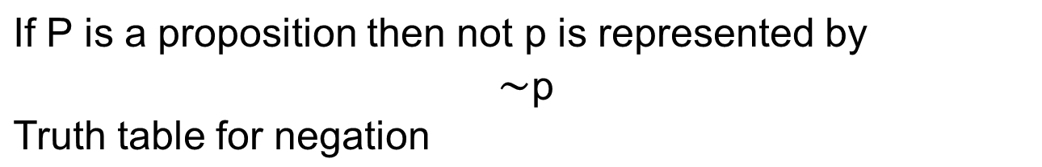
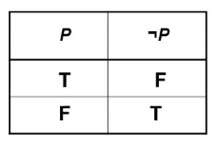
Negation
p: I like dogs
~p: I do not like dogs

Slide 14
Negation Examples
Write the negation of the following propositions:
    p: y>3
    ~p: y<3
    p: x < -1
    ~p: x>-1
    p: It is sunny
    ~p: It is not sunny
Discrete Mathematics - BSCS

Slide 15

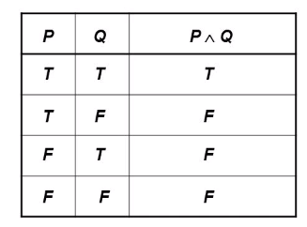
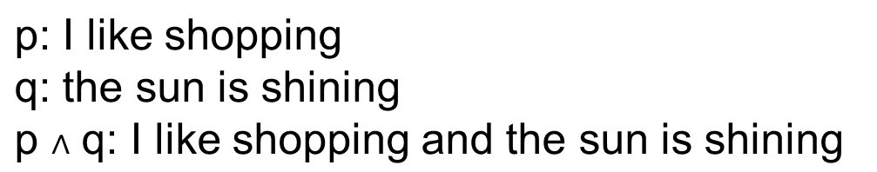
The AND operator

Slide 16
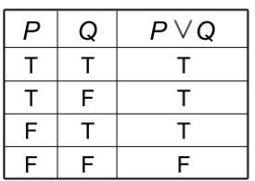
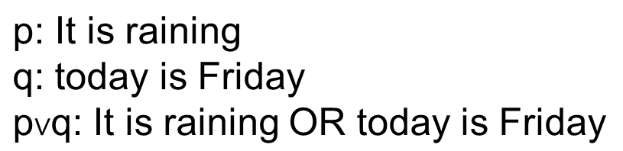
The OR operator
Represented by symbol V

Slide 17
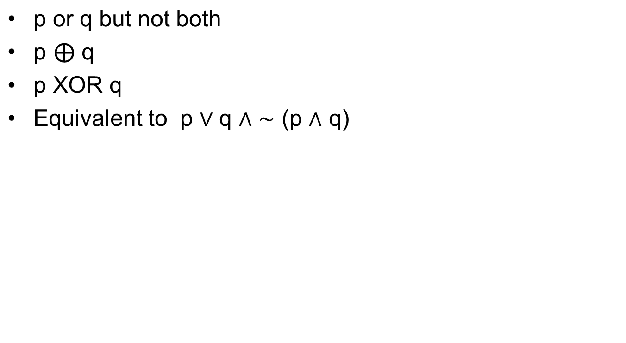
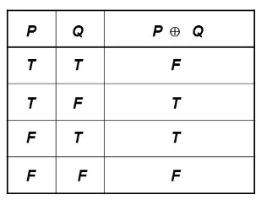
Exclusive OR
Discrete Mathematics - BSCS

Slide 18
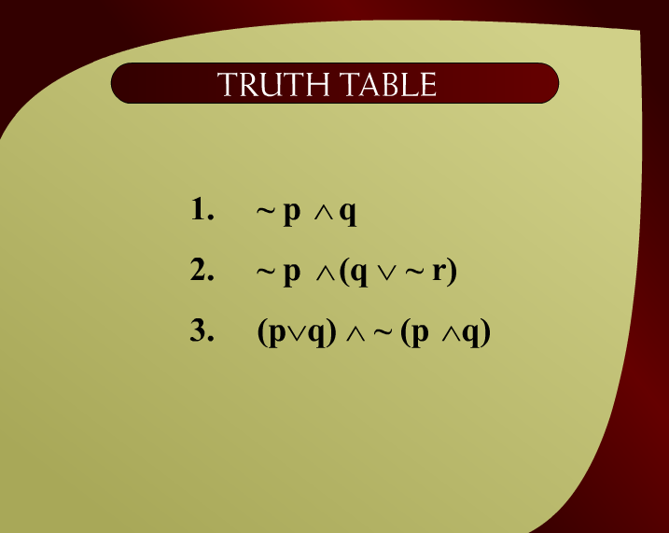
Truth Table
Discrete Mathematics - BSCS

Slide 19
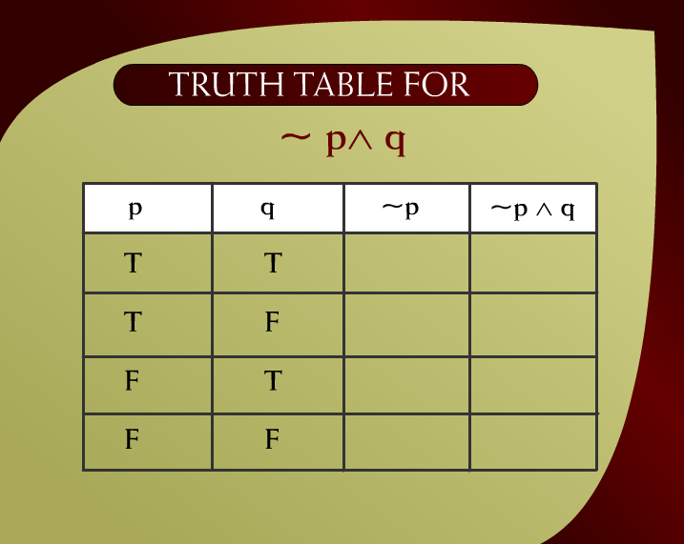
Truth Table for ~p^q - 2
Discrete Mathematics - BSCS

Slide 20
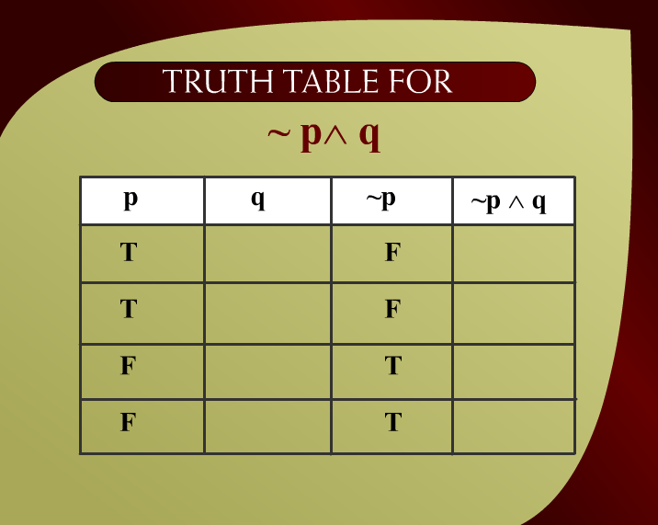
Truth Table for ~p^q – 2a
Discrete Mathematics - BSCS

Slide 21
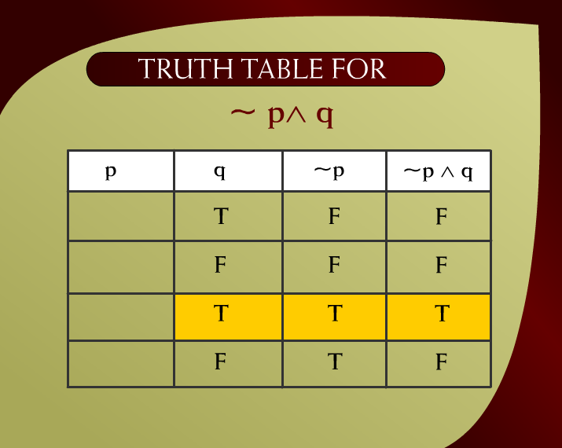
Truth Table for ~p^q – 2b
Discrete Mathematics - BSCS

Slide 22
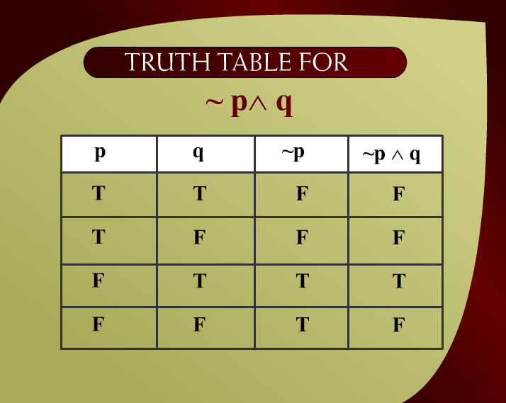
Truth Table for ~p^q – 2c
Discrete Mathematics - BSCS

Slide 23
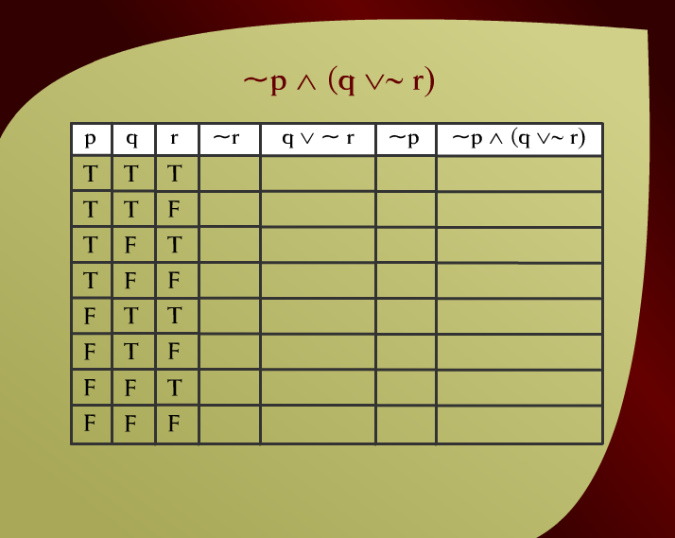
~p ^ (q v~ r) – (2 - 3a)
Discrete Mathematics - BSCS

Slide 24

~p ^ (q v~ r) – 2 - 3b
Discrete Mathematics - BSCS

Slide 25
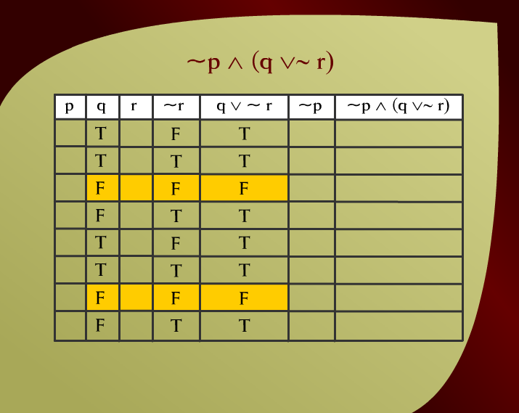
~p ^ (q v~ r) – 2 - 3c
Discrete Mathematics - BSCS

Slide 26
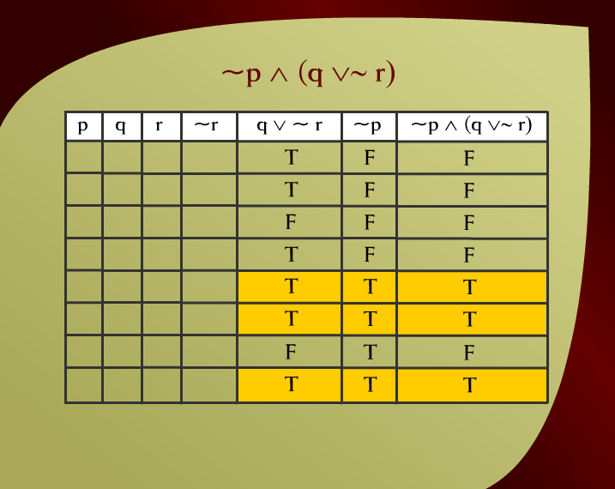
~p ^ (q v~ r) – 2 - 3d
Discrete Mathematics - BSCS

Slide 27

Truth Table for ~p (p v~ q) – 2 - 3e
v
Discrete Mathematics - BSCS

Slide 28
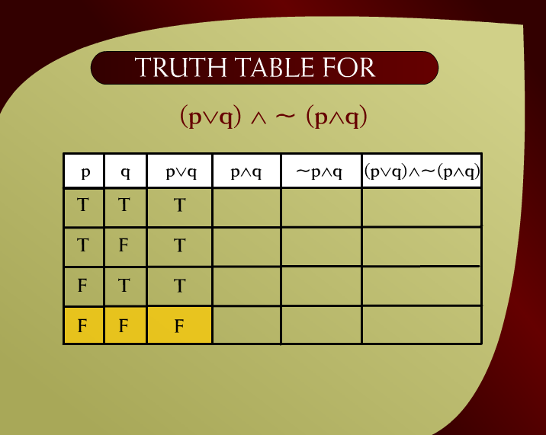
Truth Table for (pvq) ^~ (p^q) – 2 - 4a
Discrete Mathematics - BSCS

Slide 29
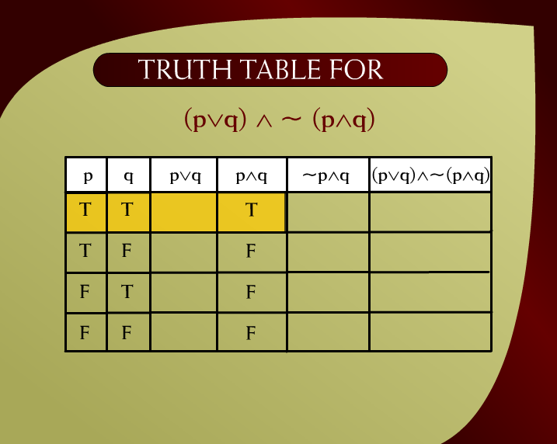
Truth Table for (pvq) ^~ (p^q) – 2 - 4c
Discrete Mathematics - BSCS

Slide 30
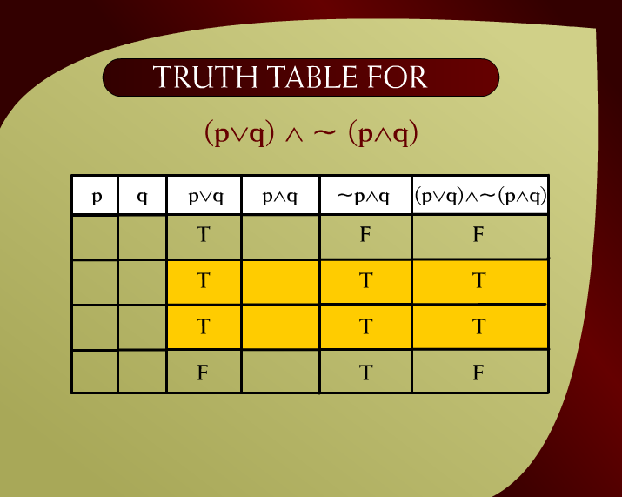
Truth Table for (pvq) ^~ (p^q) – 2 - 4e
v
v
Discrete Mathematics - BSCS

Slide 31
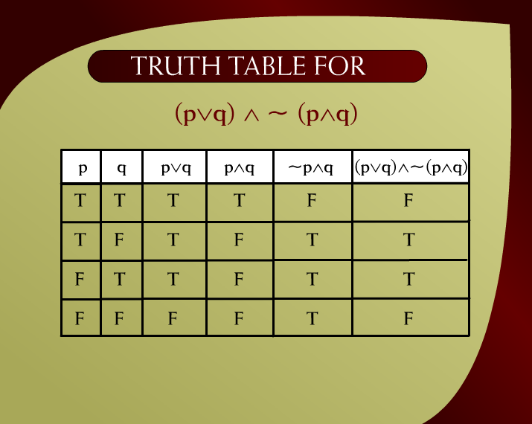
Truth Table for (pvq) ^~ (p^q) – 2 -4f
Discrete Mathematics - BSCS

Slide 32
Logical Equivalence
Two statement forms are logically equivalent if and only if they have identical truth table.
Written as p ≡ q

Slide 33
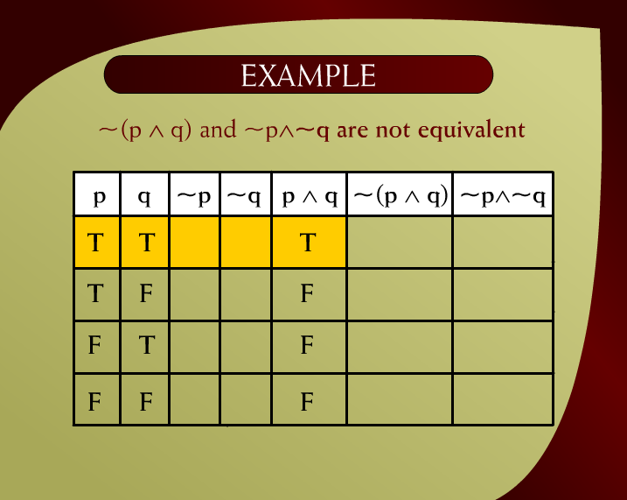
Example – 2 - 17d
Discrete Mathematics - BSCS

Slide 34
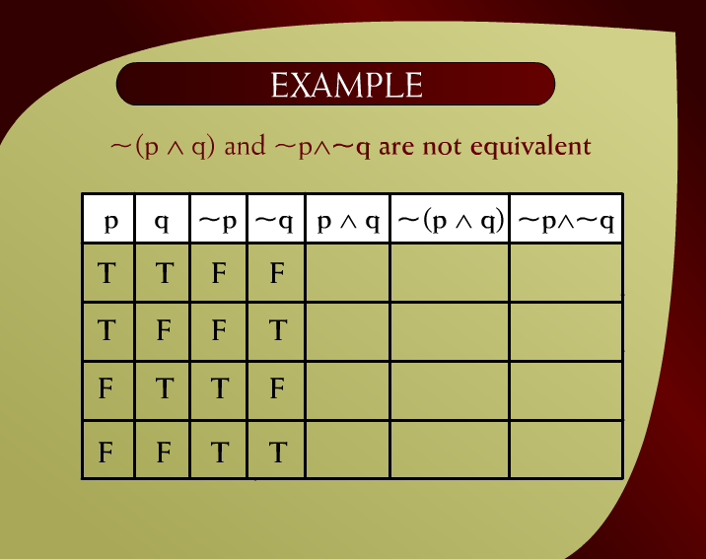
Example – 2 - 17c
Discrete Mathematics - BSCS

Slide 35
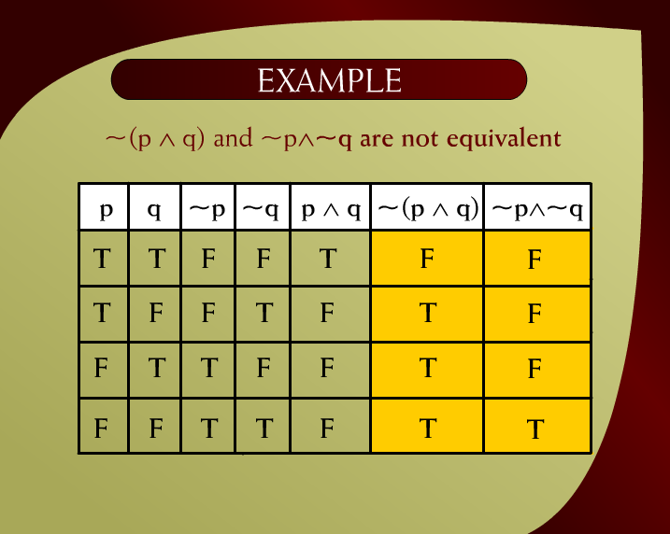
Example – 2 - 17e
Discrete Mathematics - BSCS

Slide 36
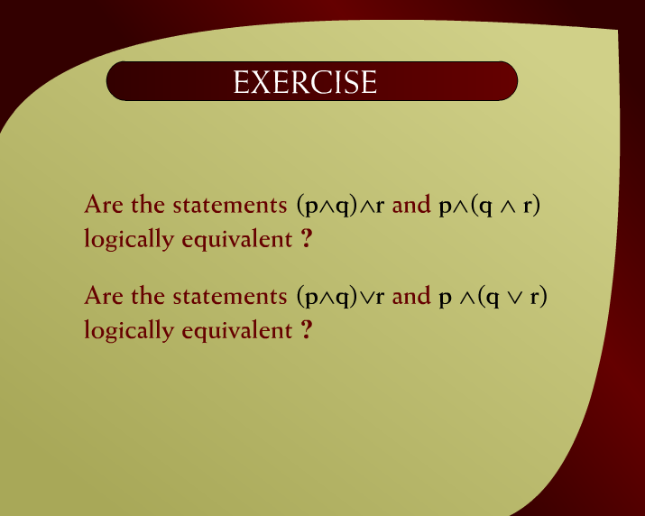
Exercise – 2 - 19
Discrete Mathematics - BSCS

Slide 37
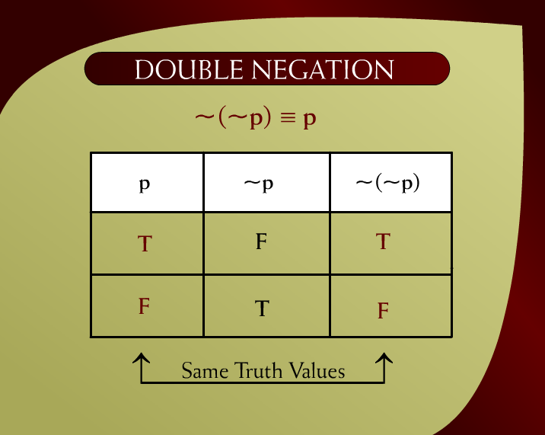
Double Negation ~(~p) ≡ p – 2 - 7
Discrete Mathematics - BSCS

Slide 38
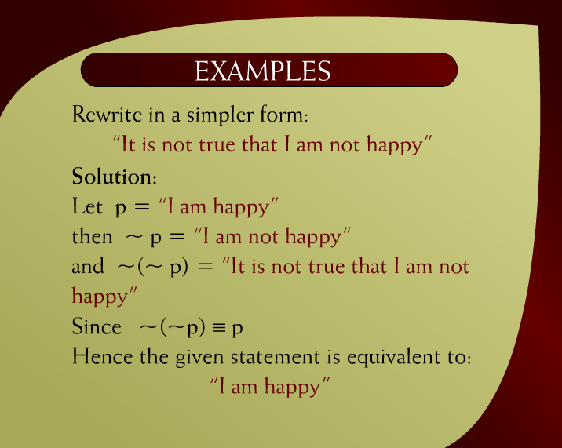
Examples – 2 - 12
Discrete Mathematics - BSCS

Slide 39
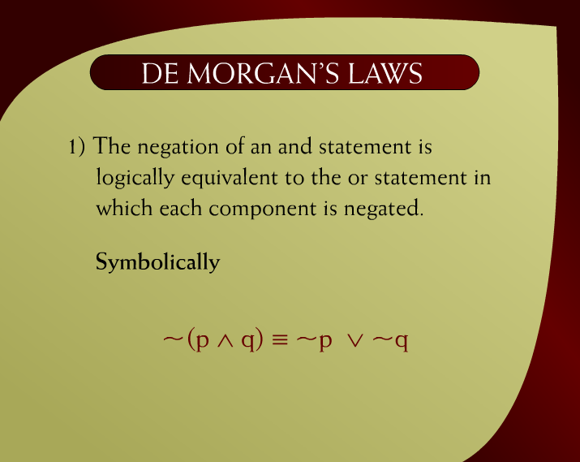
De Morgan’s Laws – 2 - 9
Discrete Mathematics - BSCS

Slide 40
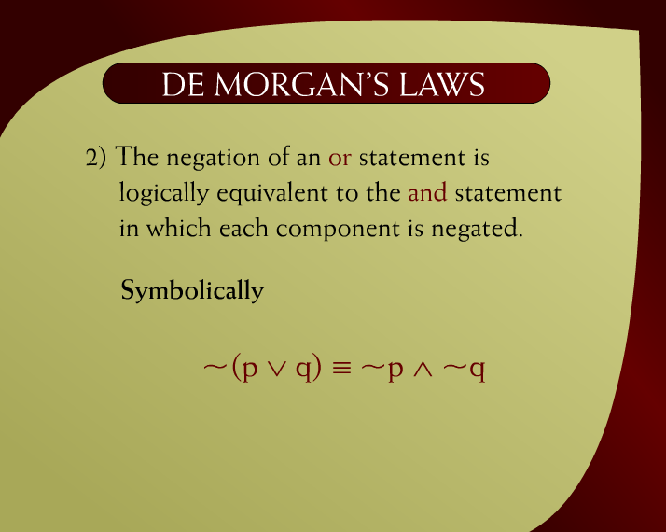
De Morgan’s Laws – 2 - 9a
Discrete Mathematics - BSCS

Slide 41
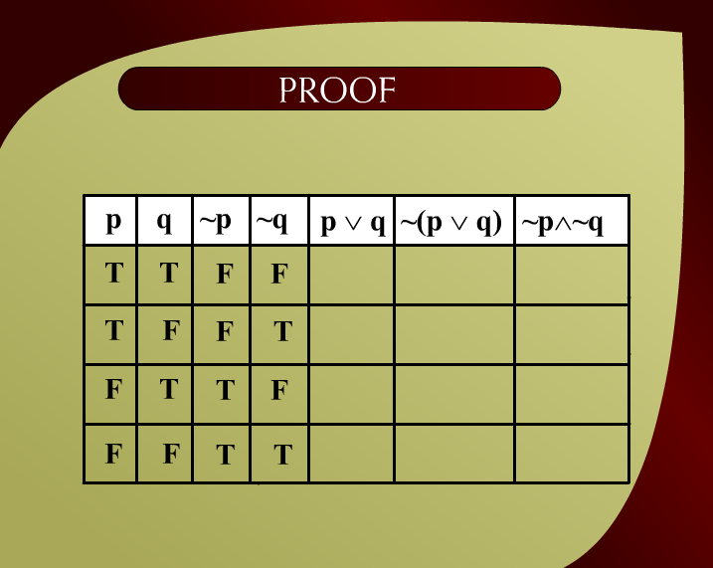
Proof – 2 - 16
Discrete Mathematics - BSCS

Slide 42
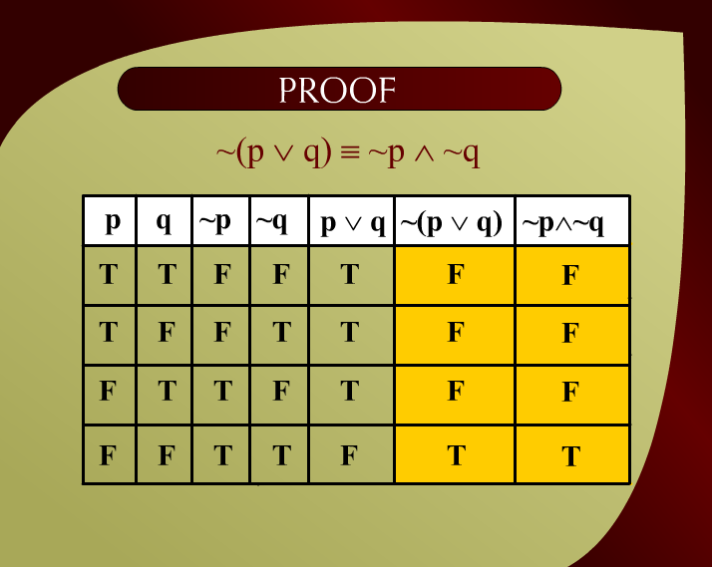
Proof – 2 - 16d
Discrete Mathematics - BSCS

Slide 43

Application – 2 - 10
Discrete Mathematics - BSCS

Slide 44
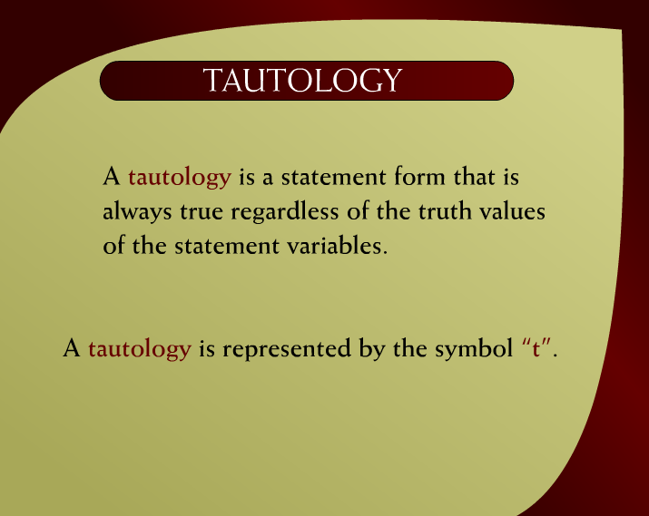
Tautology – 2 - 21
Discrete Mathematics - BSCS

Slide 45
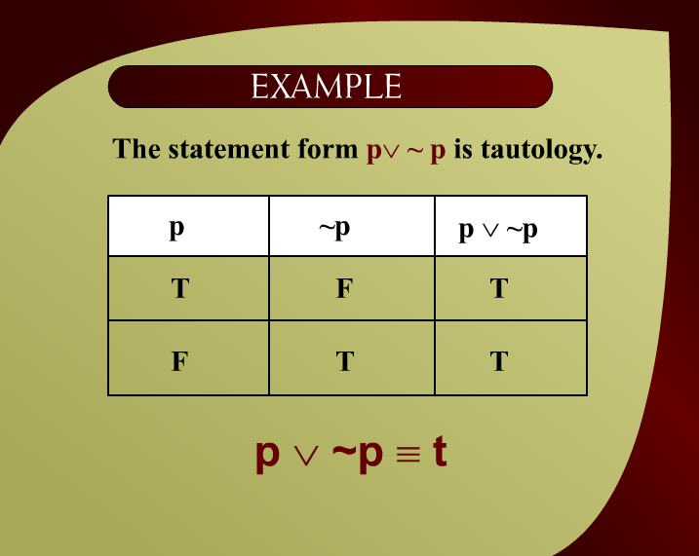
Example – 2 - 21a
Discrete Mathematics - BSCS

Slide 46
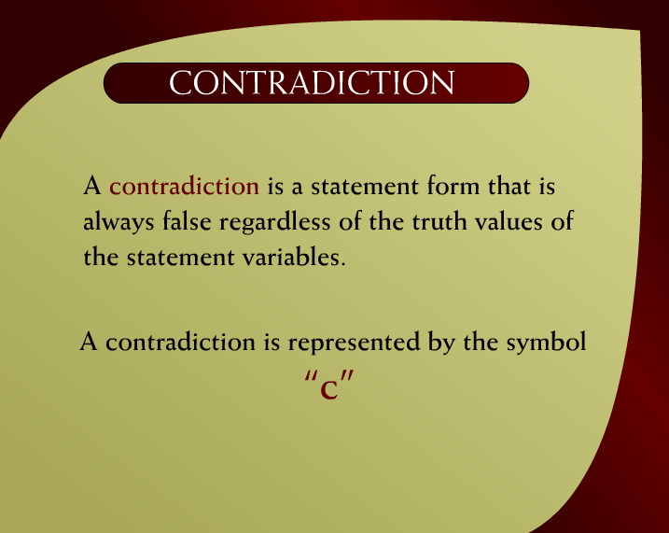
Contradiction – 2 - 22
Discrete Mathematics - BSCS

Slide 47

Example – 2 - 22a
Discrete Mathematics - BSCS

Slide 48
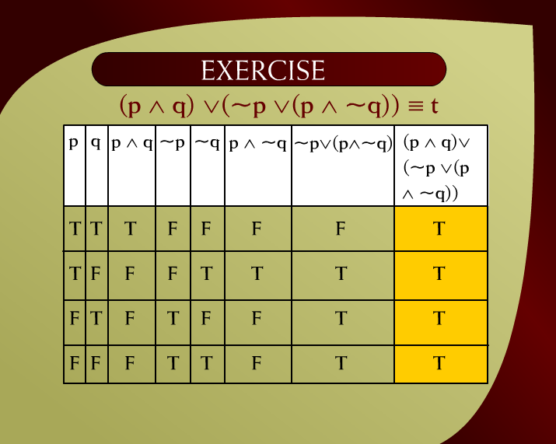
Exercise – 2 - 23
Discrete Mathematics - BSCS

Slide 49
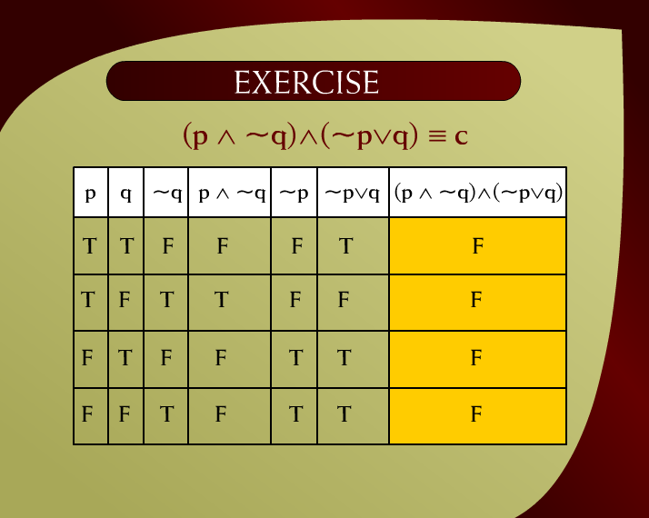
Exercise – 2 - 24
Discrete Mathematics - BSCS

Slide 50
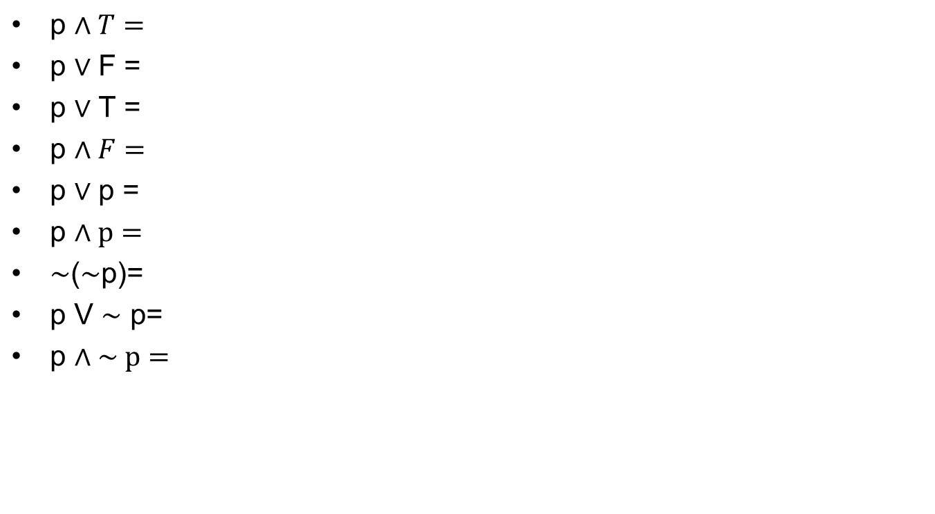
Class Activity

Slide 51
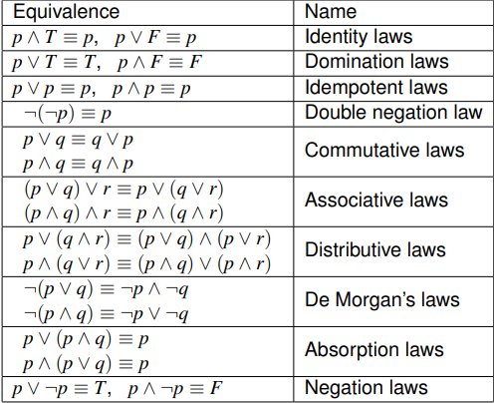
Discrete Mathematics - BSCS

Slide 52
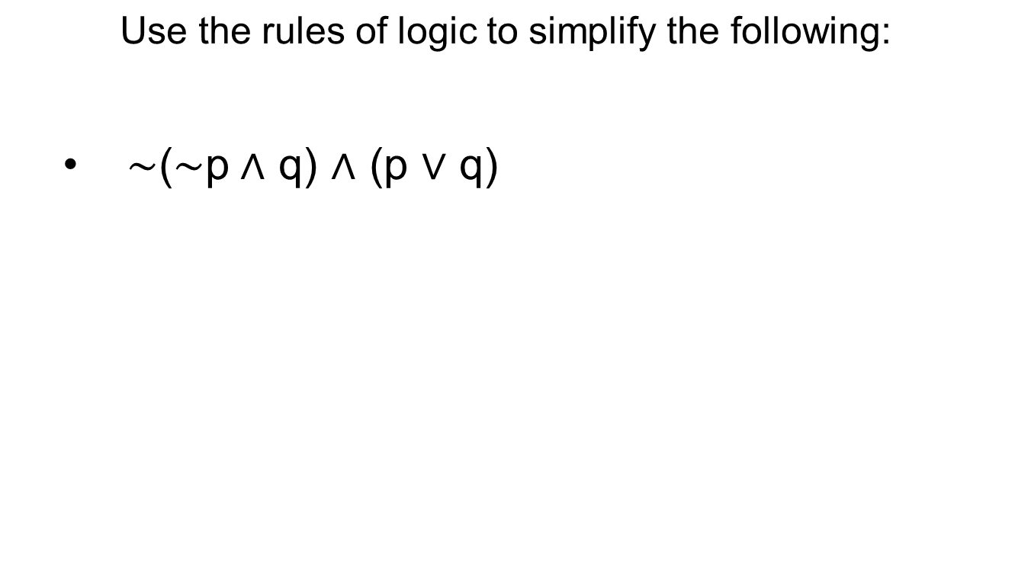
Simplify the statement
Discrete Mathematics - BSCS

Slide 53
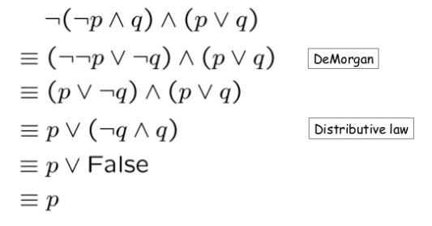
Simplify the statement
Discrete Mathematics - BSCS

